Slide 1
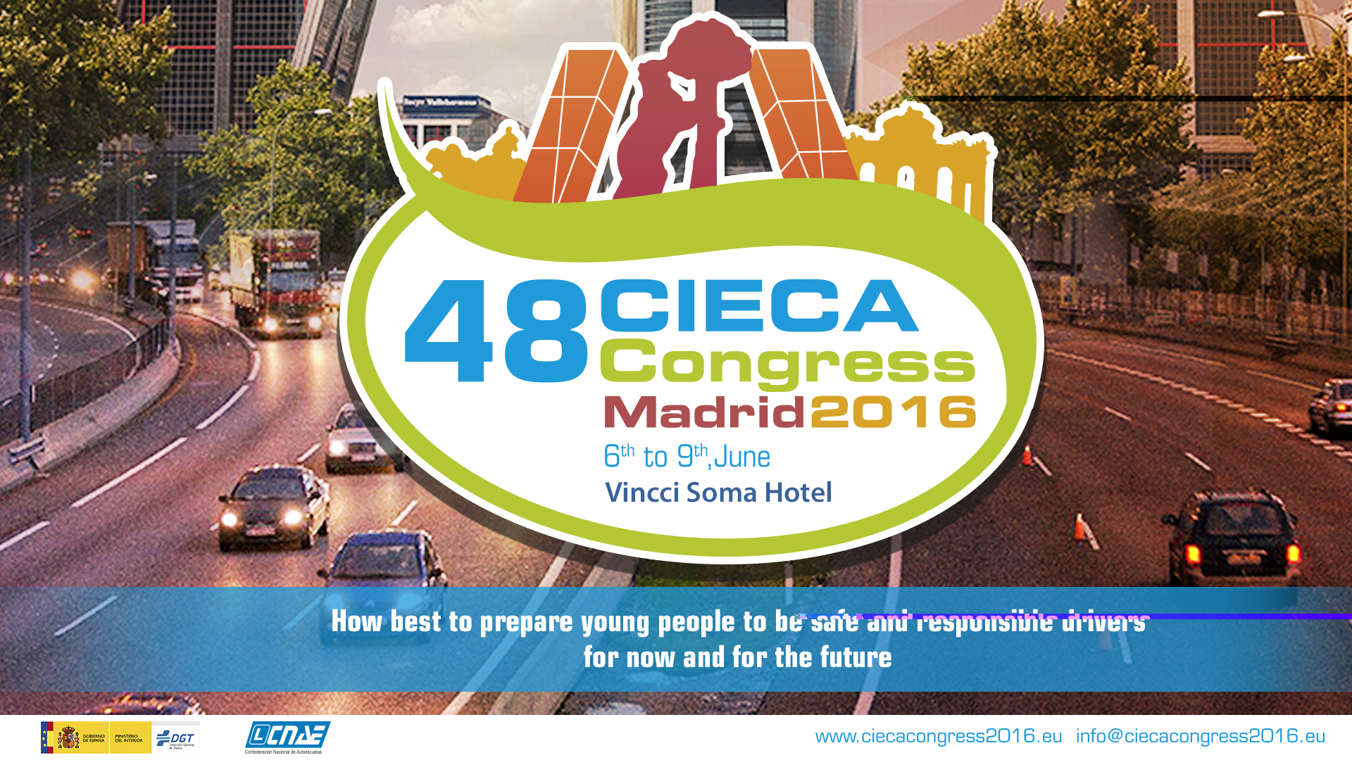
Connected mobility: A challenge for a traffic authority

Slide 2

GLOBAL CONTEXT
1.25 million people die each year as a result of road traffic crashes.
90% of the world's fatalities on the roads occur in low- and middle-income countries, even though these countries have approximately half of the world's vehicles.
Every 25 seconds a road user will die
Notes:
· Public roads: More than 660,000 km. (Road network: 165,595 + Interurban roads City Councils: 361,000 + Urban roads City Councils: 128,000 + Roads owned by other bodies 11,300). Source: 2012 Statistical Yearbook from Ministry of Development and survey conducted in 1998.

Slide 3


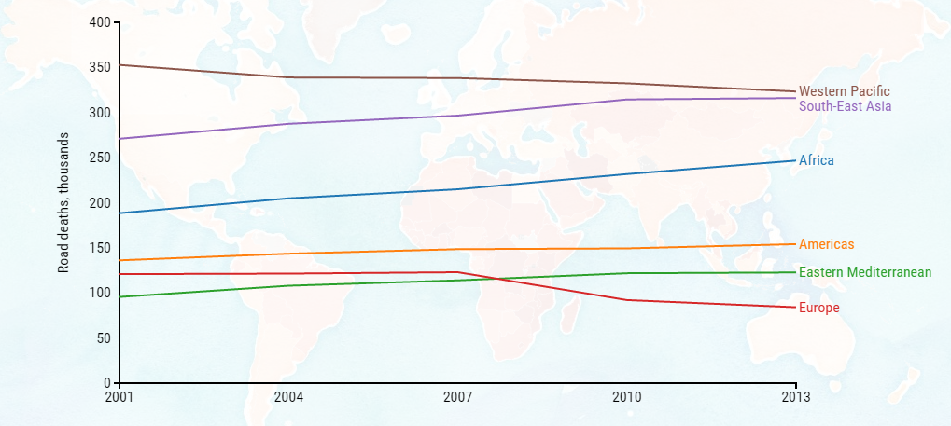
GLOBAL CONTEXT
Ambitious target to decrease road fatalities
  OMS: -50% 2020
Notes:
· Public roads: More than 660,000 km. (Road network: 165,595 + Interurban roads City Councils: 361,000 + Urban roads City Councils: 128,000 + Roads owned by other bodies 11,300). Source: 2012 Statistical Yearbook from Ministry of Development and survey conducted in 1998.

Slide 4

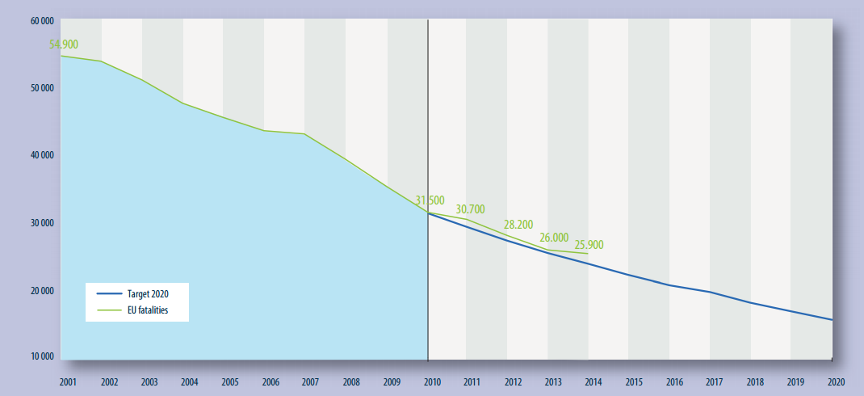
GLOBAL CONTEXT
Ambitious target to decrease road fatalities
  UE: -50% 2020
Notes:
· Public roads: More than 660,000 km. (Road network: 165,595 + Interurban roads City Councils: 361,000 + Urban roads City Councils: 128,000 + Roads owned by other bodies 11,300). Source: 2012 Statistical Yearbook from Ministry of Development and survey conducted in 1998.

Slide 5
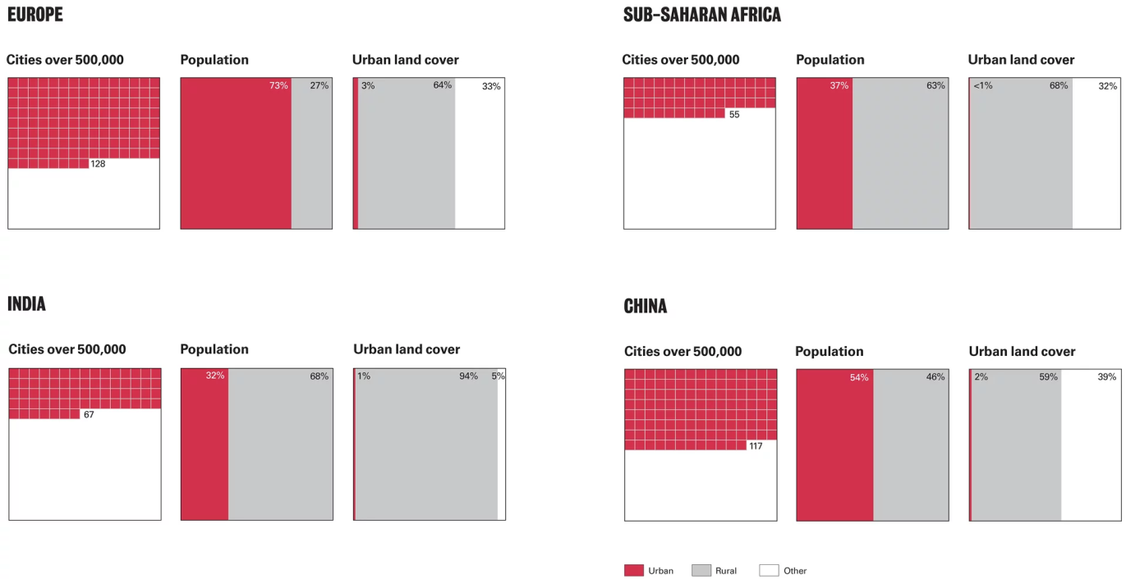
GLOBAL CONTEXT
The world is heading towards 70% urbanisation by 2050.
Increased travel needs
Transport (public/share) is a key element
Notes:
· Public roads: More than 660,000 km. (Road network: 165,595 + Interurban roads City Councils: 361,000 + Urban roads City Councils: 128,000 + Roads owned by other bodies 11,300). Source: 2012 Statistical Yearbook from Ministry of Development and survey conducted in 1998.

Slide 6
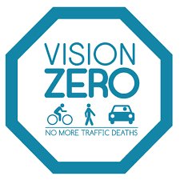
GLOBAL CONTEXT
Vision zero.
No loss of life is acceptable
We are humans and we make mistakes
Vehicle technology can fill these gaps
Notes:
· Public roads: More than 660,000 km. (Road network: 165,595 + Interurban roads City Councils: 361,000 + Urban roads City Councils: 128,000 + Roads owned by other bodies 11,300). Source: 2012 Statistical Yearbook from Ministry of Development and survey conducted in 1998.

Slide 7

DISRUPTIVE TRENDS
CONNECTED VEHICLES
AUTOMATED VEHICLES
“The automotive industry will see more changes in the next five years than in the previous 50 years,” Mary Barra, CEO of GM.
Notes:
· Public roads: More than 660,000 km. (Road network: 165,595 + Interurban roads City Councils: 361,000 + Urban roads City Councils: 128,000 + Roads owned by other bodies 11,300). Source: 2012 Statistical Yearbook from Ministry of Development and survey conducted in 1998.

Slide 8

Connected vehicles
Notes:
· Public roads: More than 660,000 km. (Road network: 165,595 + Interurban roads City Councils: 361,000 + Urban roads City Councils: 128,000 + Roads owned by other bodies 11,300). Source: 2012 Statistical Yearbook from Ministry of Development and survey conducted in 1998.

Slide 9
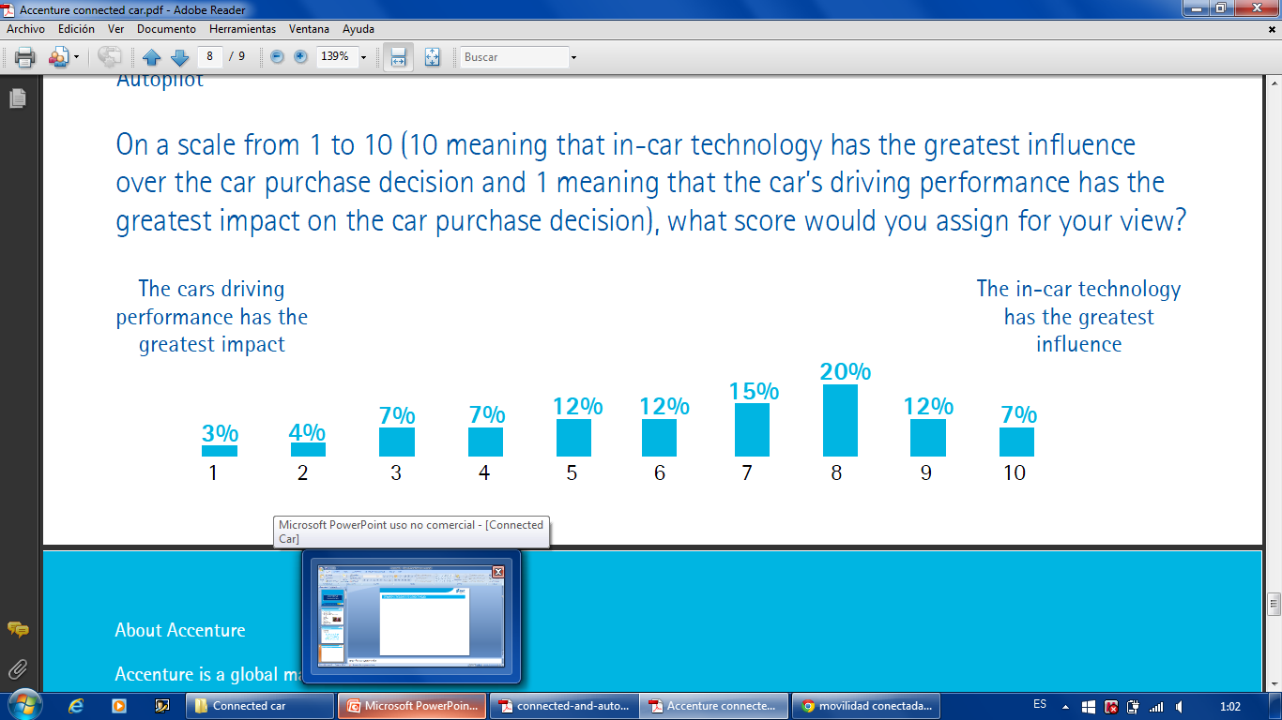
CONNECTED VEHICLES
Increased connectivity.
2.6 billions of smartphones.
Connected citizens demand connected vehicles
Notes:
· Public roads: More than 660,000 km. (Road network: 165,595 + Interurban roads City Councils: 361,000 + Urban roads City Councils: 128,000 + Roads owned by other bodies 11,300). Source: 2012 Statistical Yearbook from Ministry of Development and survey conducted in 1998.

Slide 10

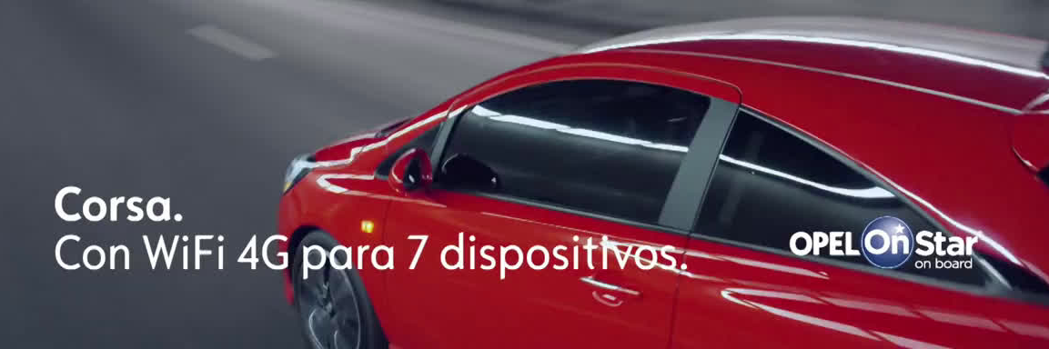
CONNECTED VEHICLES
OEMs uses connectivity services as a sales hook
Notes:
· Public roads: More than 660,000 km. (Road network: 165,595 + Interurban roads City Councils: 361,000 + Urban roads City Councils: 128,000 + Roads owned by other bodies 11,300). Source: 2012 Statistical Yearbook from Ministry of Development and survey conducted in 1998.

Slide 11
CONNECTED VEHICLES
Connectivity can be provided through:
  Embedded systems
  Aftermarket/smartphone
Since 2018 (ecall) new vehicles will include a sim card
By 2020 90% of the vehicles will have connectivity
Notes:
· Public roads: More than 660,000 km. (Road network: 165,595 + Interurban roads City Councils: 361,000 + Urban roads City Councils: 128,000 + Roads owned by other bodies 11,300). Source: 2012 Statistical Yearbook from Ministry of Development and survey conducted in 1998.

Slide 12
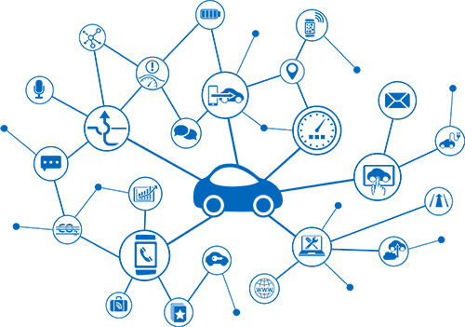
CONNECTED VEHICLES
Services that can be provided:
  Infotainment
  Safety
  Efficient mobility
  Efficient economy
  Conveinance
Notes:
· Public roads: More than 660,000 km. (Road network: 165,595 + Interurban roads City Councils: 361,000 + Urban roads City Councils: 128,000 + Roads owned by other bodies 11,300). Source: 2012 Statistical Yearbook from Ministry of Development and survey conducted in 1998.

Slide 13
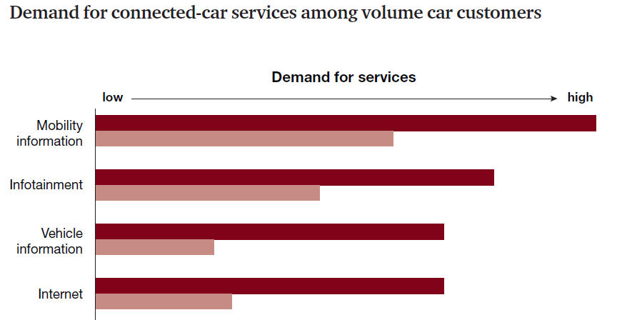
CONNECTED VEHICLES
Customers are willing to pay in certain services:
Notes:
· Public roads: More than 660,000 km. (Road network: 165,595 + Interurban roads City Councils: 361,000 + Urban roads City Councils: 128,000 + Roads owned by other bodies 11,300). Source: 2012 Statistical Yearbook from Ministry of Development and survey conducted in 1998.

Slide 14
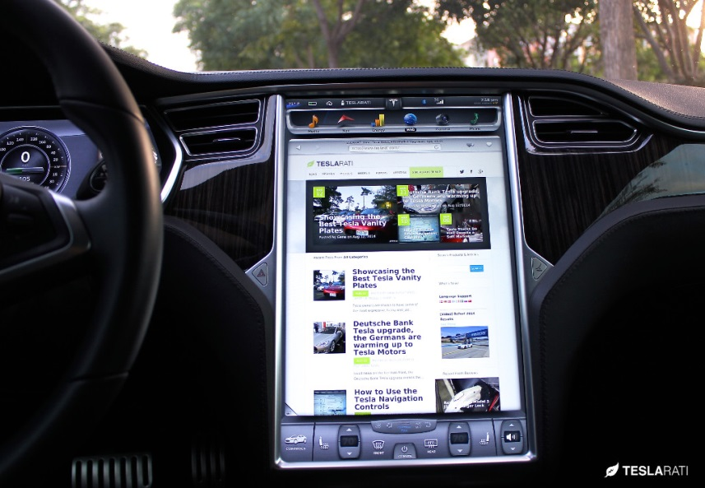
CONNECTED VEHICLES
Services that can be provided:
  Infotainment
    Wifi
    Music streaming
    Social networks
Notes:
· Public roads: More than 660,000 km. (Road network: 165,595 + Interurban roads City Councils: 361,000 + Urban roads City Councils: 128,000 + Roads owned by other bodies 11,300). Source: 2012 Statistical Yearbook from Ministry of Development and survey conducted in 1998.

Slide 15
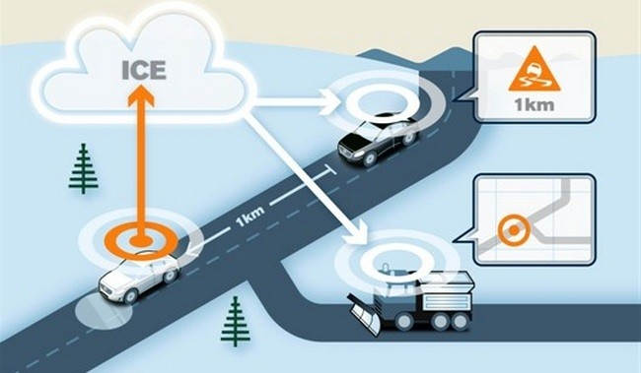
CONNECTED VEHICLES
Services that can be provided:
  Safety
    Ecall
    Geofencing
    Remote vehicle diagnostics
Notes:
· Public roads: More than 660,000 km. (Road network: 165,595 + Interurban roads City Councils: 361,000 + Urban roads City Councils: 128,000 + Roads owned by other bodies 11,300). Source: 2012 Statistical Yearbook from Ministry of Development and survey conducted in 1998.

Slide 16
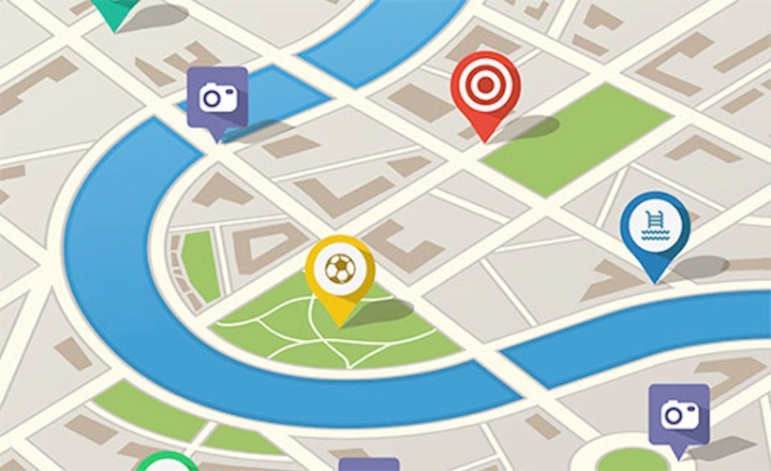
CONNECTED VEHICLES
Services that can be provided:
  Efficient mobility
    Real Time Traffic
    Digital maps
    Parking info
    Estimated time of arrival
    MaaS
Notes:
· Public roads: More than 660,000 km. (Road network: 165,595 + Interurban roads City Councils: 361,000 + Urban roads City Councils: 128,000 + Roads owned by other bodies 11,300). Source: 2012 Statistical Yearbook from Ministry of Development and survey conducted in 1998.

Slide 17
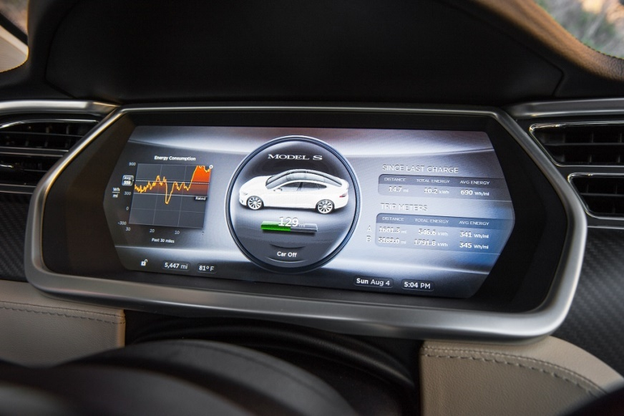
CONNECTED VEHICLES
Services that can be provided:
  Efficient economy
    Auto insurance – pay as you drive
    Smart driving assistance
    Fleet management
Notes:
· Public roads: More than 660,000 km. (Road network: 165,595 + Interurban roads City Councils: 361,000 + Urban roads City Councils: 128,000 + Roads owned by other bodies 11,300). Source: 2012 Statistical Yearbook from Ministry of Development and survey conducted in 1998.

Slide 18

CONNECTED VEHICLES
The vehicle (and its data) becomes the starring.
Wide variety of data: position, use of lights, rpm, wipers, temperature, fuel consumption, breakdowns, etc.
Privacy
Ownership
Big Data
Notes:
· Public roads: More than 660,000 km. (Road network: 165,595 + Interurban roads City Councils: 361,000 + Urban roads City Councils: 128,000 + Roads owned by other bodies 11,300). Source: 2012 Statistical Yearbook from Ministry of Development and survey conducted in 1998.

Slide 19
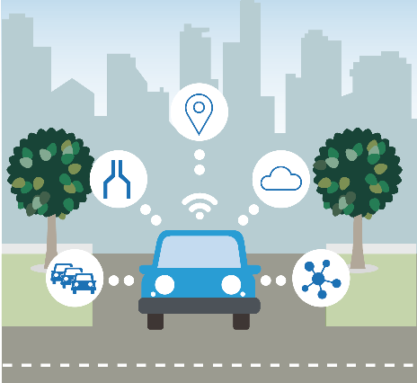
CONNECTED VEHICLES
Traffic administration & connected vehicles:
  Important opportunity for road safety improvement
  Win-Win approach
  The data will be anonymised
  Promote connectivity services that improve mobility or road safety
  Enforcement out of the scope
  Service platform/hub
Notes:
· Public roads: More than 660,000 km. (Road network: 165,595 + Interurban roads City Councils: 361,000 + Urban roads City Councils: 128,000 + Roads owned by other bodies 11,300). Source: 2012 Statistical Yearbook from Ministry of Development and survey conducted in 1998.

Slide 20
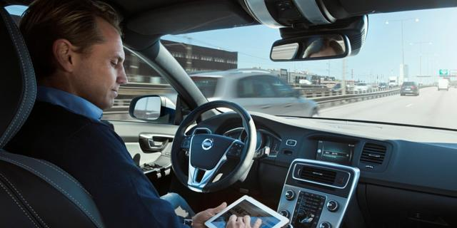
Autonomous vehicles
Notes:
· Public roads: More than 660,000 km. (Road network: 165,595 + Interurban roads City Councils: 361,000 + Urban roads City Councils: 128,000 + Roads owned by other bodies 11,300). Source: 2012 Statistical Yearbook from Ministry of Development and survey conducted in 1998.

Slide 21
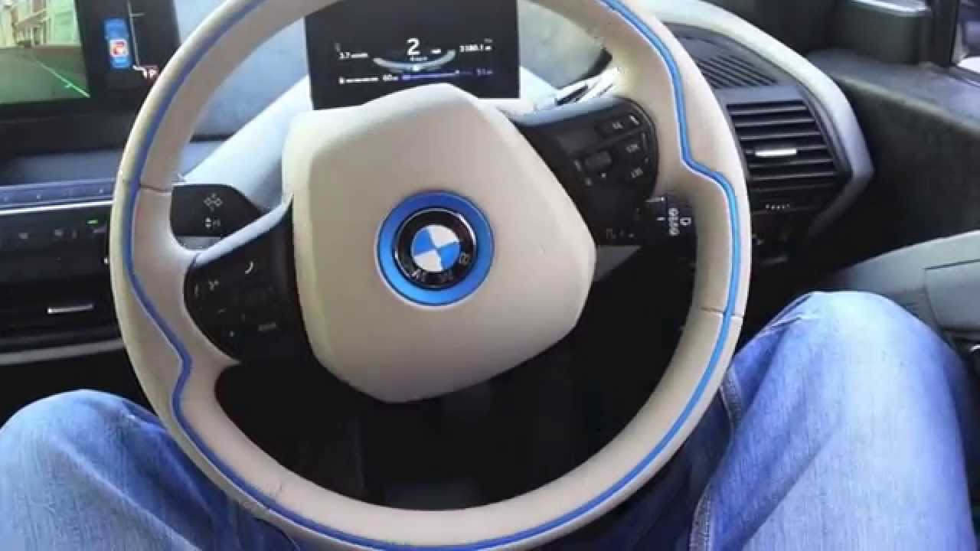
AUTONOMOUS VEHICLES
It’s a major technological advancement influencing and shaping our future mobility and quality of life.
The automated driving features are a reality in nowadays cars:
  Advanced Driver Assistant Systems (ADAS)
  AD features in commercial vehicles
    BMW – Self parking assistant
    Tesla – Autopilot
    Mercedes – Drive Pilot
    VW – Traffic Jam Assist
Notes:
· Public roads: More than 660,000 km. (Road network: 165,595 + Interurban roads City Councils: 361,000 + Urban roads City Councils: 128,000 + Roads owned by other bodies 11,300). Source: 2012 Statistical Yearbook from Ministry of Development and survey conducted in 1998.

Slide 22
AUTONOMOUS VEHICLES
The main benefits are:
  Safety: Reduce accidents caused by human errors.
  Efficiency and environmental objectives: Increase transport system efficiency and reduce time in congested traffic. Smoother traffic will help to decrease the energy consumption and emissions of the vehicles.
  Comfort: Enable user’s freedom for other activities when automated systems are active.
  Social inclusion: Ensure mobility for all, including elderly and impaired users.
  Accessibility: Facilitate access to city centres.
Notes:
· Public roads: More than 660,000 km. (Road network: 165,595 + Interurban roads City Councils: 361,000 + Urban roads City Councils: 128,000 + Roads owned by other bodies 11,300). Source: 2012 Statistical Yearbook from Ministry of Development and survey conducted in 1998.

Slide 23
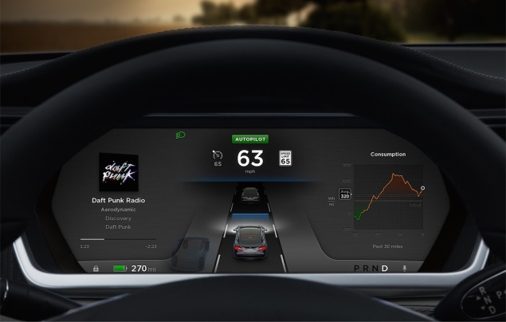
AUTONOMOUS VEHICLES
The economic impact projected for autonomous driving for the years to come ranging up to €71bn in 2030.
The estimated global market for automated vehicles is 44 million vehicles by 2030.
The industrial sector and the legal framework needs to evolve and adapt in a fast pace to stay ahead in global competitiveness.
Notes:
· Public roads: More than 660,000 km. (Road network: 165,595 + Interurban roads City Councils: 361,000 + Urban roads City Councils: 128,000 + Roads owned by other bodies 11,300). Source: 2012 Statistical Yearbook from Ministry of Development and survey conducted in 1998.

Slide 24
AUTONOMOUS VEHICLES
Spain has defined the different levels of automation
For the higher level (5) the driver doesn’t apply.
It would not be necessary a driving license for level 5.
Notes:
· Public roads: More than 660,000 km. (Road network: 165,595 + Interurban roads City Councils: 361,000 + Urban roads City Councils: 128,000 + Roads owned by other bodies 11,300). Source: 2012 Statistical Yearbook from Ministry of Development and survey conducted in 1998.

Slide 25
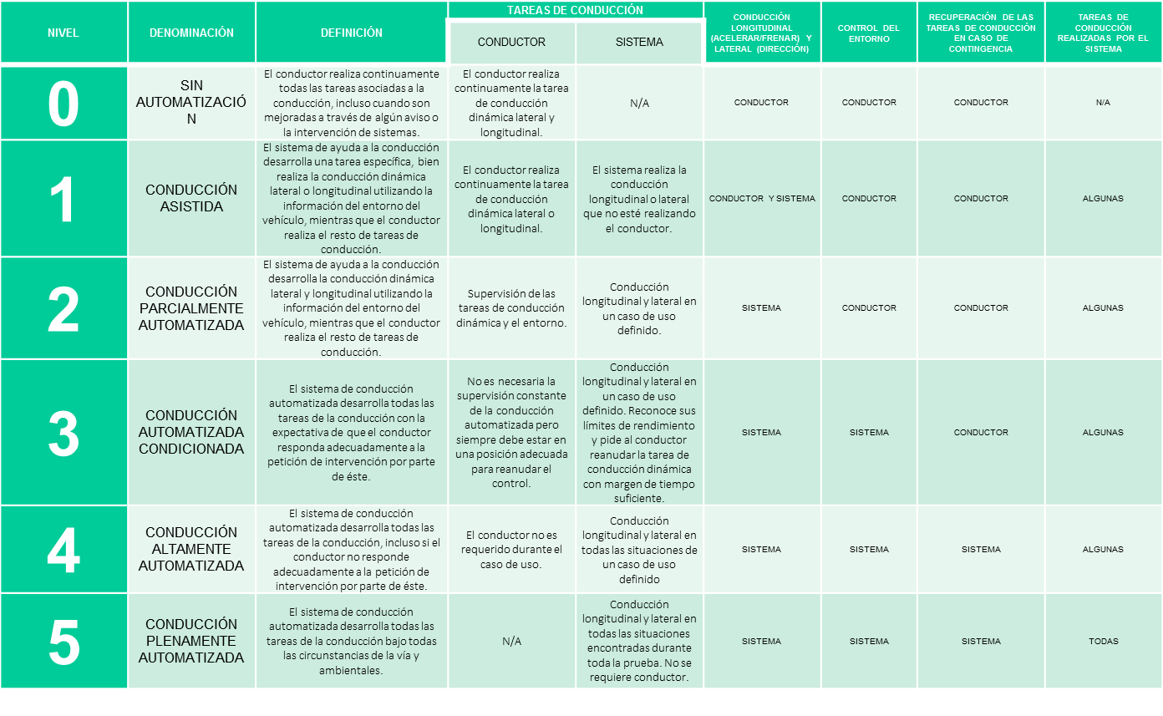
Notes:
· Public roads: More than 660,000 km. (Road network: 165,595 + Interurban roads City Councils: 361,000 + Urban roads City Councils: 128,000 + Roads owned by other bodies 11,300). Source: 2012 Statistical Yearbook from Ministry of Development and survey conducted in 1998.

Slide 26
AUTONOMOUS VEHICLES
What role has to play a national traffic administration?
  Neutral.
  Promote a stable regulatory framework.
  Promote testing and operations of autonomous cars in real traffic.
  Attract investments for national Research institutes and industries.
  Inform of the benefits of Autonomous driving to rise the public acceptance. Demonstrate Reliability, Safety and Robustness of Technology. There is no margin for error with safety-critical technologies. They must work perfectly every time.
Notes:
· Public roads: More than 660,000 km. (Road network: 165,595 + Interurban roads City Councils: 361,000 + Urban roads City Councils: 128,000 + Roads owned by other bodies 11,300). Source: 2012 Statistical Yearbook from Ministry of Development and survey conducted in 1998.

Slide 27
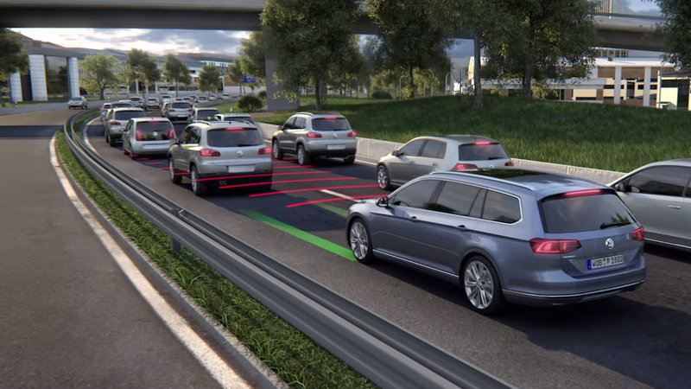
AUTONOMOUS VEHICLES
What role has to play a national traffic administration?
  Demonstrate Reliability, Safety and Robustness of Technology.
  There is no margin for error with safety-critical technologies. They must work perfectly every time.
Notes:
· Public roads: More than 660,000 km. (Road network: 165,595 + Interurban roads City Councils: 361,000 + Urban roads City Councils: 128,000 + Roads owned by other bodies 11,300). Source: 2012 Statistical Yearbook from Ministry of Development and survey conducted in 1998.

Slide 28
AUTONOMOUS VEHICLES
SPAIN - State of art
  Regulatory framework for the testing and operation of vehicles on public roads (not specific for autonomous driving).
  Autonomous vehicles have been already tested.
  100 km corridor GALICIA equipped with several V2X communications systems, sensors and cooperative systems.
Notes:
· Public roads: More than 660,000 km. (Road network: 165,595 + Interurban roads City Councils: 361,000 + Urban roads City Councils: 128,000 + Roads owned by other bodies 11,300). Source: 2012 Statistical Yearbook from Ministry of Development and survey conducted in 1998.

Slide 29
AUTONOMOUS VEHICLES
SPAIN - State of art
  The Spanish automotive industry is a world reference.
  The companies automakers and components form a tandem recognized prestige in terms of competitiveness and performance
  Important innovation and research centers.
  Spain has not ratified Vienna Convention.
Notes:
· Public roads: More than 660,000 km. (Road network: 165,595 + Interurban roads City Councils: 361,000 + Urban roads City Councils: 128,000 + Roads owned by other bodies 11,300). Source: 2012 Statistical Yearbook from Ministry of Development and survey conducted in 1998.

Slide 30
AUTONOMOUS VEHICLES
SPAIN - State of art
  Working groups – legal framework
    Insurance and responsibility
    Draft of a new Vehicle code including autonomous driving.
  Promoting real tests of AD vehicles in Spain/Europe
Notes:
· Public roads: More than 660,000 km. (Road network: 165,595 + Interurban roads City Councils: 361,000 + Urban roads City Councils: 128,000 + Roads owned by other bodies 11,300). Source: 2012 Statistical Yearbook from Ministry of Development and survey conducted in 1998.

Slide 31
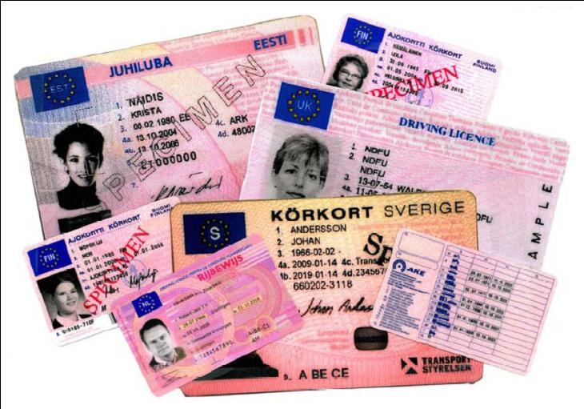
And what about driving licences?
Notes:
· Public roads: More than 660,000 km. (Road network: 165,595 + Interurban roads City Councils: 361,000 + Urban roads City Councils: 128,000 + Roads owned by other bodies 11,300). Source: 2012 Statistical Yearbook from Ministry of Development and survey conducted in 1998.

Slide 32
DRIVING LICENSE
For some levels of AD its not going to be necessary
Specialization
“Business as usual” its not going to work in the future
Work closely with OEMs
The technology (AD) makes driving easier and safer
Notes:
· Public roads: More than 660,000 km. (Road network: 165,595 + Interurban roads City Councils: 361,000 + Urban roads City Councils: 128,000 + Roads owned by other bodies 11,300). Source: 2012 Statistical Yearbook from Ministry of Development and survey conducted in 1998.

Slide 33

Conclusion
Notes:
· Public roads: More than 660,000 km. (Road network: 165,595 + Interurban roads City Councils: 361,000 + Urban roads City Councils: 128,000 + Roads owned by other bodies 11,300). Source: 2012 Statistical Yearbook from Ministry of Development and survey conducted in 1998.

Slide 34
CONCLUSION
Disruptive changes
New business models
The vehicle (and its technology) gains relevance
Great opportunity to achieve the objectives of Vision Zero.
Notes:
· Public roads: More than 660,000 km. (Road network: 165,595 + Interurban roads City Councils: 361,000 + Urban roads City Councils: 128,000 + Roads owned by other bodies 11,300). Source: 2012 Statistical Yearbook from Ministry of Development and survey conducted in 1998.

Slide 35
THANKS YOU FOR YOUR ATTENTION

